Slide 1
ESP – Electrical Submersible Pumps

Slide 2
What are ESPs?

Slide 3
Well Characteristics
High gas/oil ratios (GOR)
Viscous crudes
High temperature
Operation on variable speed controllers (VSC)

Slide 4
Advantages
Efficient and reliable artificial-lift method for lifting moderate to high volumes of fluids from wellbores.
Volumes 150 to 150,000 Barrels/Day

Slide 5
ESP Components
Centrifugal Pump
3-phase Induction Motor
Seal Chamber
Power Cable
Surface Controls
Pump on top, Motor attached below

Slide 6
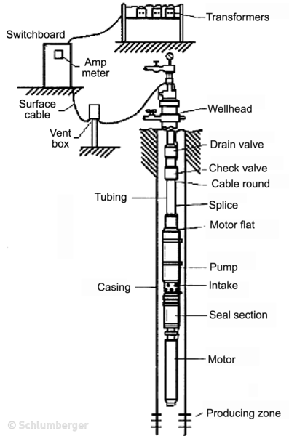

Slide 7
Why do ESP’s fail?
Percentage of Solids (Sand)
Downhole Failures
Maintenance properties are learned after disassembly after they are pulled from the well

Slide 8
Bottomhole Sensing Device
The downhole sensors provide continuous measurement of parameters :
Wellbore pressures
Wellbore or ESP temperature
Discharge flow rates
Water contamination of the motor
Equipment vibration

Slide 9
What we use to Predict Failures
Current (min, max, average)
Voltage (min, max, average for time periods)
Intake Pressure
PressureROC (Rate of Change)
1-hour Pressure, 3-hour Pressure
1-hour current, 3-hour Voltage etc

Slide 10
Questions?

Slide 11
The ESPs are fitted with downhole monitoring units that transmit streams of data back to the surface including: motor temperature, pump intake pressure, intake temperature motor vibration, and motor current.
These data can be used to develop leading indicators of failure and shutdown conditions.
Some leading indicators are simple rules e.g. if motor temperature increases by a large amount, an electrical short can be induced and the pump automatically shuts down.
Other leading indicators are more subtle combinations of changes in pressure, current and other parameters.

